Slide 1
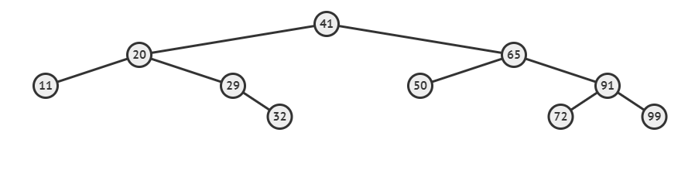
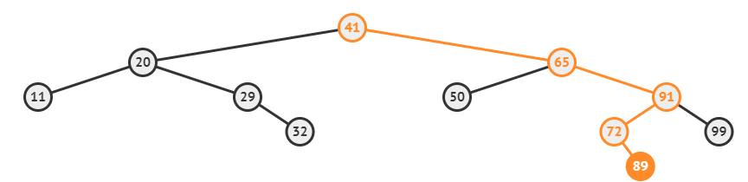

Slide 2
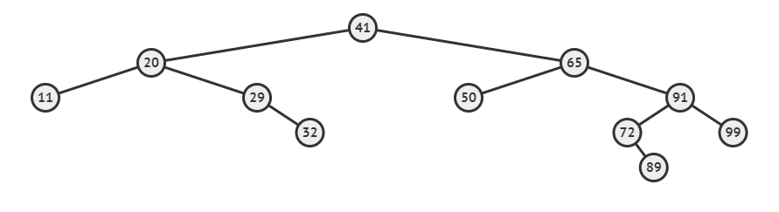
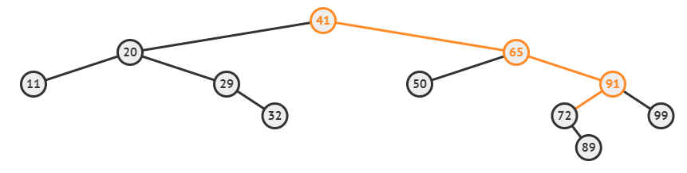
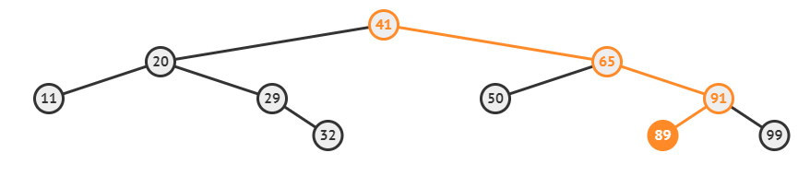

Slide 3
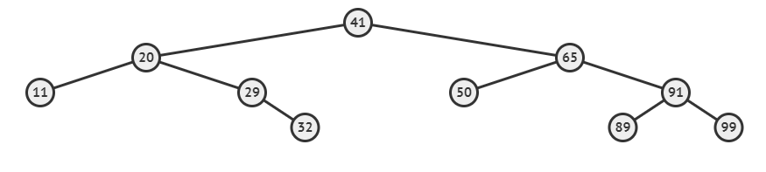
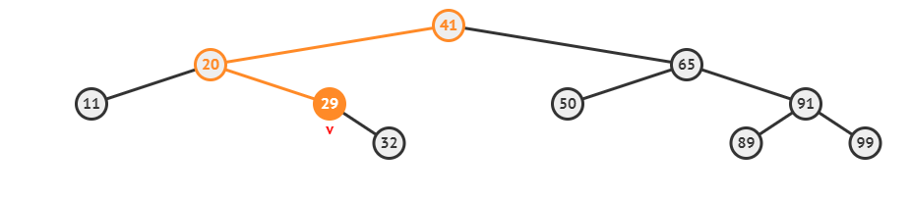

Slide 4
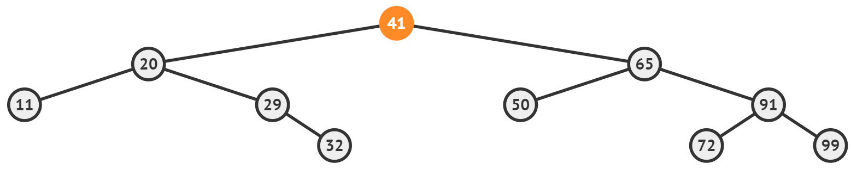
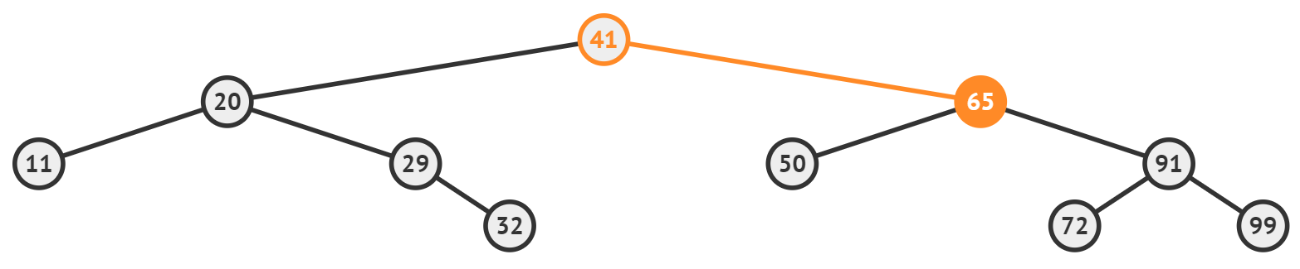
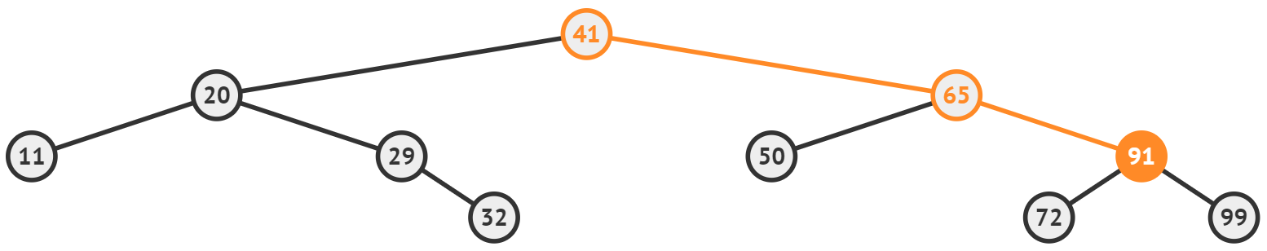
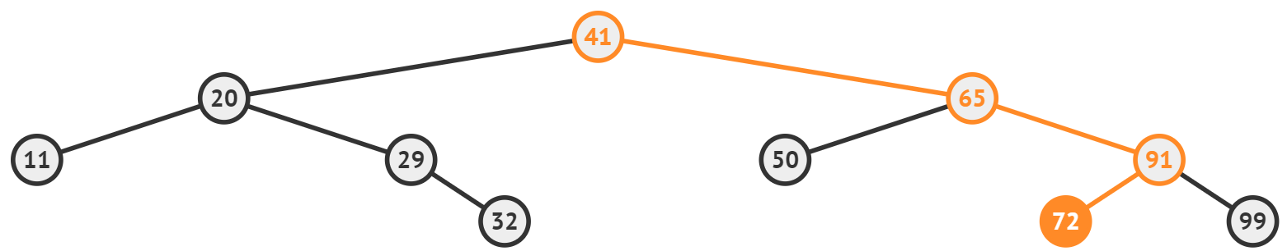
72 < 41 = False
72 < 65 = False
72 < 91 = True
Item Found

Slide 5
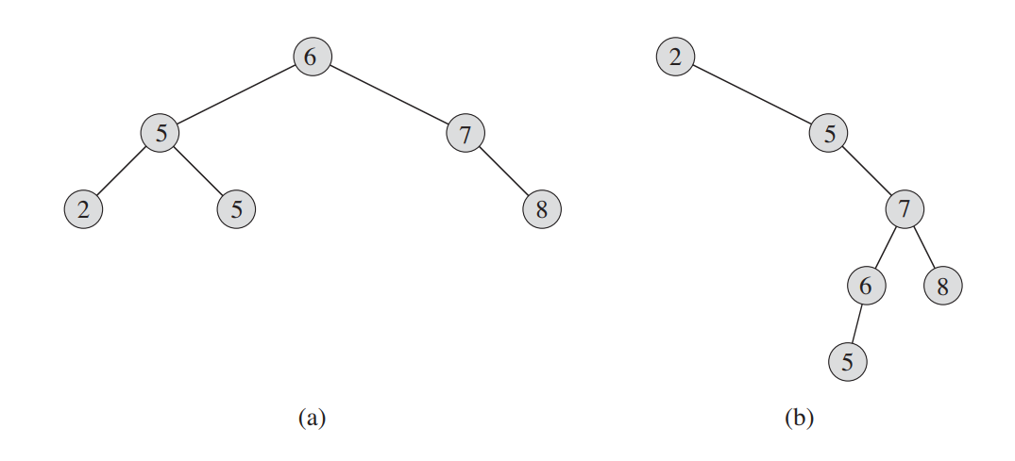
(a) Height 2 - Efficient
(b) Height 4 - Inefficient

Slide 6
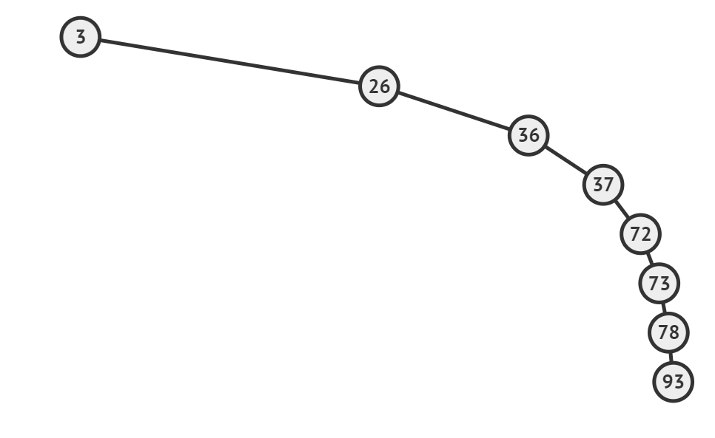

Slide 7
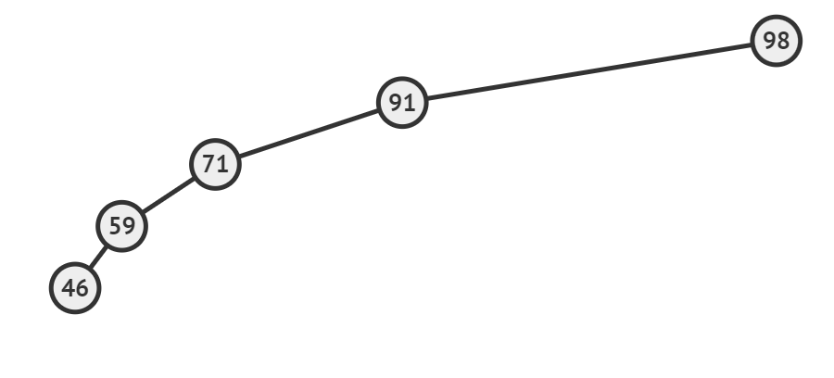

Slide 8
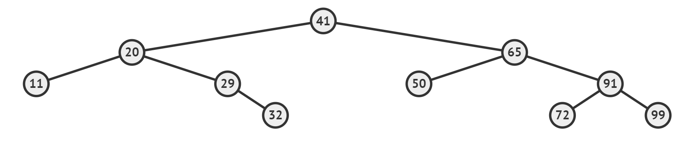

Slide 9
3
2
2
0
1
0
1
0
0
0

Slide 10
3
2
2
0
1
0
1
-1
0
0
0

Slide 11
0
1
1
3
0
1
0
0
2
2
0
0
0
0
1
0
1
-1
0
0
0

Slide 12
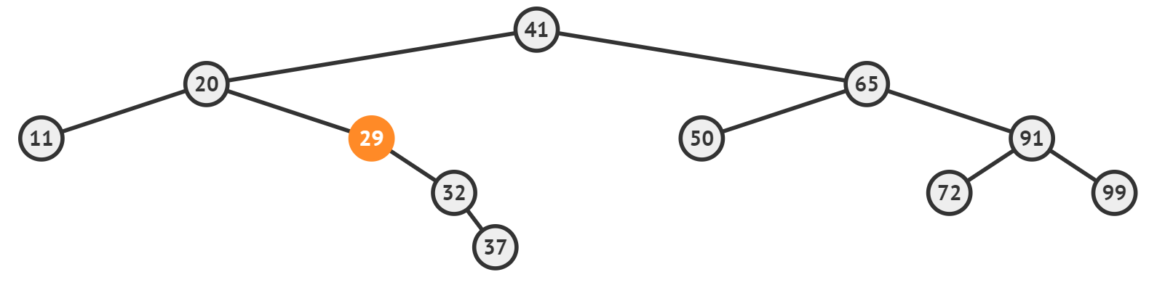

-1
-2
-1
4
0
-2
0
0
3
2
-1
0
2
0
1
0
-1
1
0
0
-1
0
Child is NULL (i.e. no child)

Slide 13
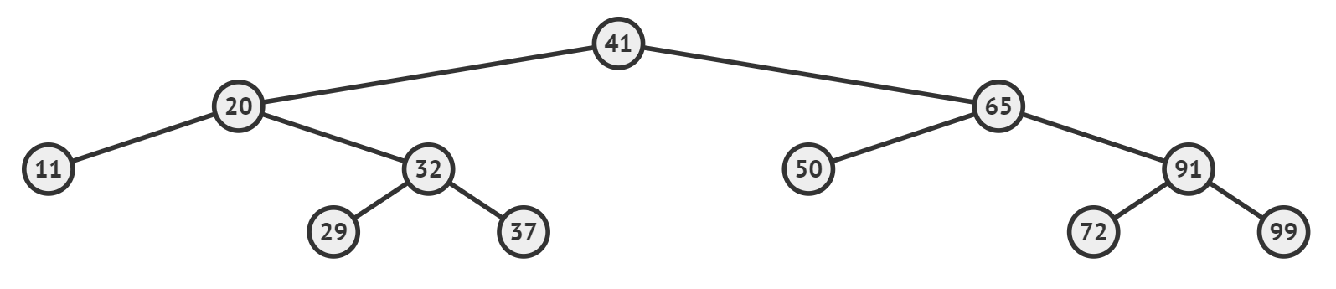
0
-1
-1
3
0
0
0
0
2
2
0
1
0
1
0
0
0
0

Slide 14
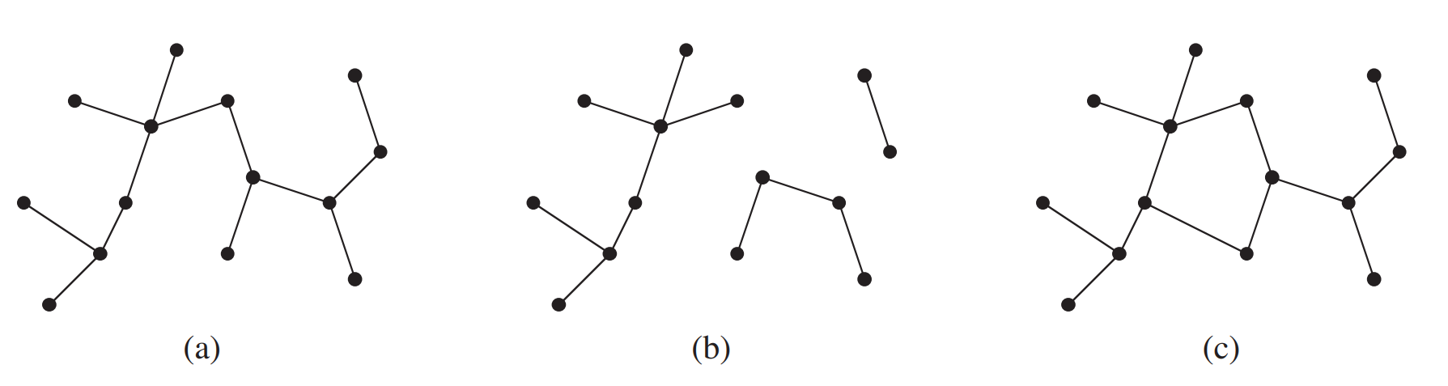
Free Tree
Not Connected
Contains a cycle

